Slide 1
TRENDS IN HRM
DR NS

Slide 2
CHANGING PATTERN OF EMPLOYMENT
1. FLEXI WORKING HRS
2. MORE WOMEN
3.pART TIME EMPLOYMENT
4. CONTRACT EMPLOYMENT
5. OUTSOURCING
6. JOB SHARING
7. TELEWORKING
8, PROJECT EMPLOYMENT

Slide 3
COMPETENCIES
CAPABILITY TO APPLY OR USE A SET OF RELATED KNOWLEDGE, SKILLS AND ABILITIES REQUIRED TO SUCCESSFULLY PERFORM WORK FUNCTIONS OR TASKS IN A DEFINED WORK SETTING.
INCLUDES-
SKILLS, KNOWLEDGE, PERSONALITY TRAITS, COMMITMENTS, ETC.
TYPES
1. ORGANISATIONAL- EXCELLENCE THROUGH VALUES , CULTURE. SKILLS, ATTITUDES.
2. CORE- KEY AREAS OF EXPERTISE, COMPETITIVE EDGE, STRENGTH APPLICATION OF KNOWLEDGE
3. TECHNICAL- KNOWHOW GOOGLE, MICROSOFT
4. BEHAVIOURAL- SOFT SKILLS- TEAM WORK, COMMUNICATION, ANALYTICAL SKILLS.

Slide 4
TYPES ……..CONTD
5. FUNCTIONAL – KNOWLEDGE WITHIN A SPECIFIC FUNCTION-
6. MGT- ATTRIBUTES & CAPABABILITIES
7.THRESHHOLD COMPETENCIES- BASIC KNOWLEDGE,SKILLS AND TRAITS

Slide 5
LEARNING ORGN
ORGN FACILITATING LEARNING – PETER SENGE.
CONTINUOUSLY TRANSFORM ITSELF.
FEATURES
1. FLEXIBLE AND UNSTRUCTURED
2. TEAM WORK
3. EMPOWERMENT
4. INFORMATION SHARING
5.SHARED VISION
6. COLLABORATION
7. ORGANISATIONAL CULTURE
8. PERSONAL MASTERY- INDIVIDUAL ENHANCES VISION

Slide 6
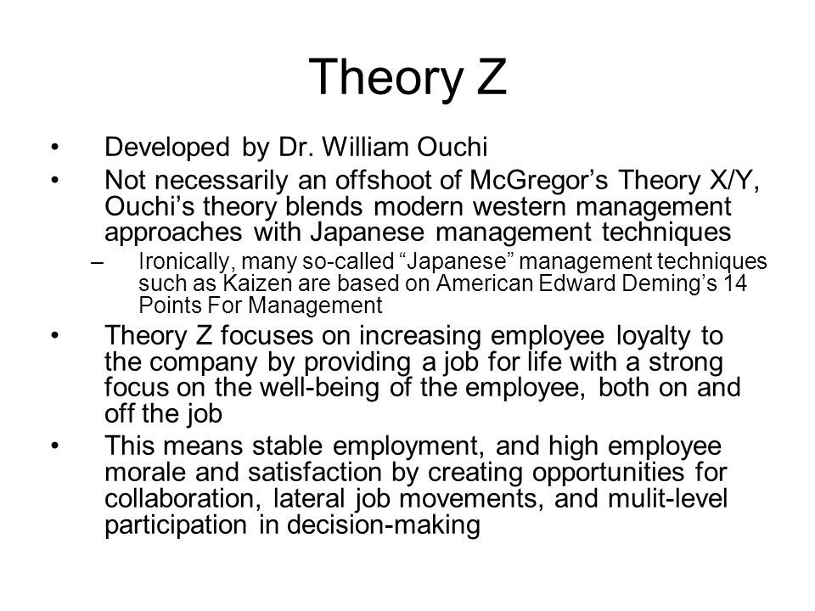
Theory z

Slide 7
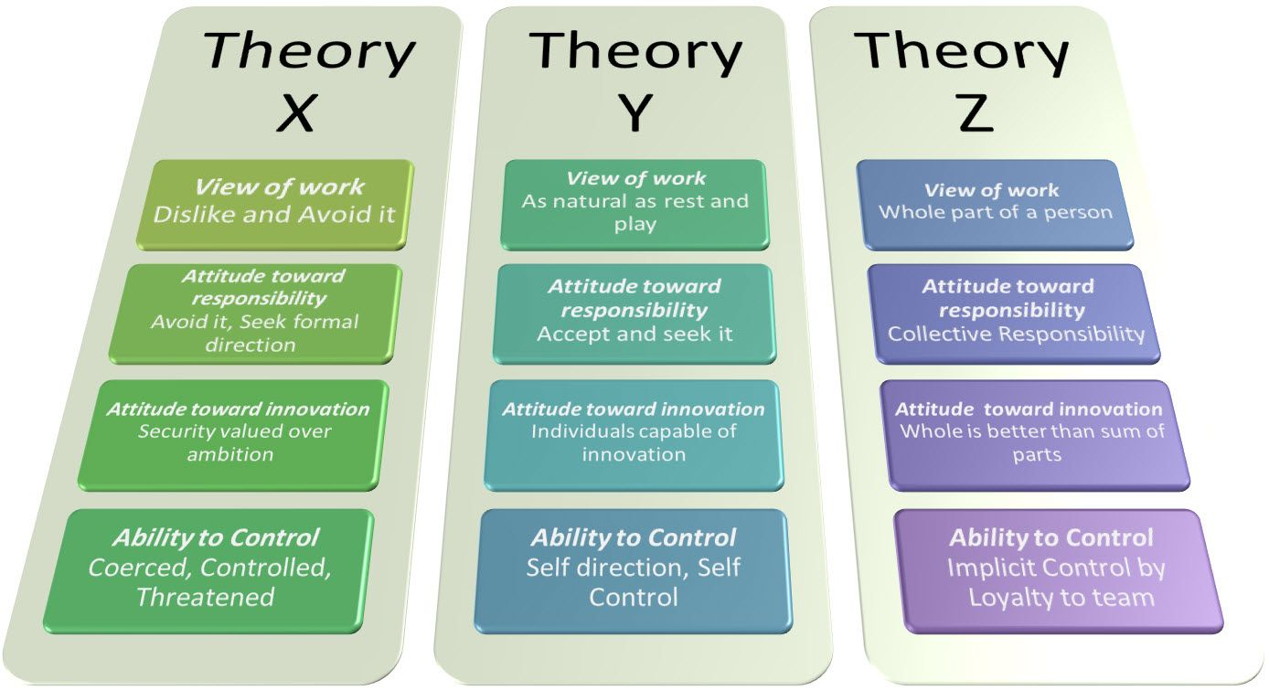

Slide 8
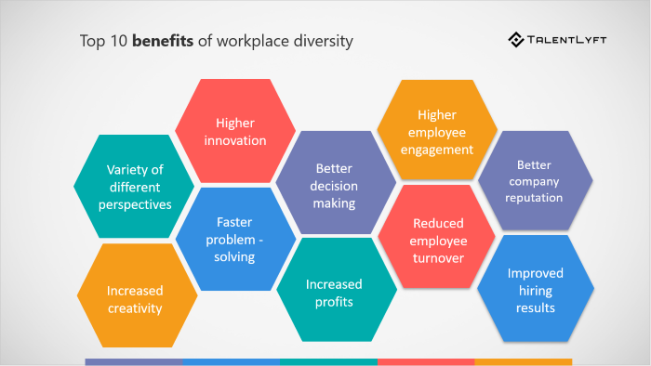
BENEFITS OF WORKFORCE DIVERSITY

Slide 9
EQ
Emotional intelligence refers to the capability of a person to manage and control his or her emotions and possess the ability to control the emotions of others as well. In other words, they can influence the emotions of other people.
DANIEL GOLEMAN

Slide 10
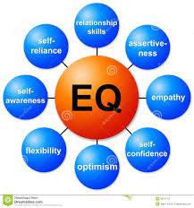
FACTORS INFLUENCING EQ

Slide 11
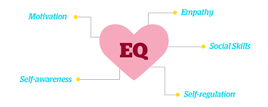
EQ

Slide 12
Competency mapping
Competency includes:
1. knowledge
2. attitude
3. skills
4.behavioural attributes
A process of identifying key competencies of an orgn and incorporating those competencies in various processes throughout the organisation

Slide 13
Process of competency mapping
Competency Mapping is a process of identifying key competencies for an organization and/or a job and incorporating those competencies throughout the various processes (i.e. job evaluation, training, recruitment) of the organization.
Job analysis
Placement
Performance appraisal
Identification of missing competencies

Slide 14
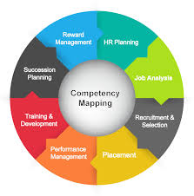

Slide 15
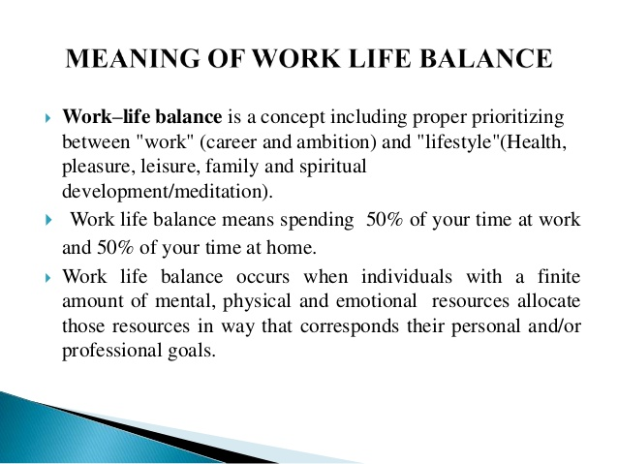
Worklife balance

Slide 16
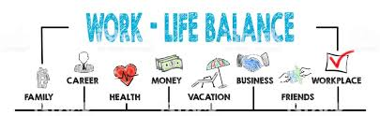
Worklife balance

